Slide 1


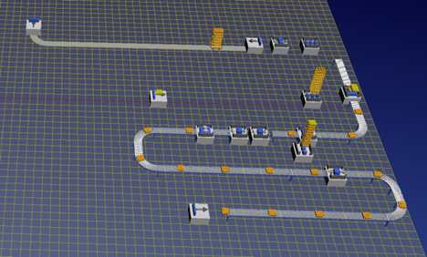
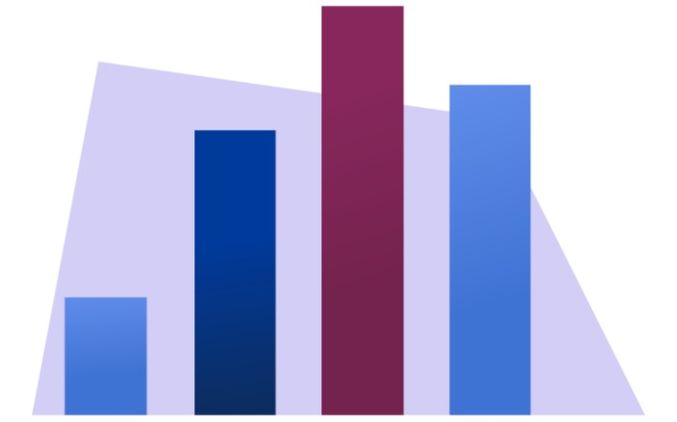
TRENDY A INOVATÍVNE PRÍSTUPY V PODNIKOVÝCH
PROCESOCH „2026“, ROČ. 29
TRENDS AND INNOVATIVE APPROACHES IN BUSINESS
PROCESSES „2026“, ROČ. 29
TITLE OF THE PAPER
Name SURNAME FIRST AUTHOR – Name SURNAME SECOND AUTHOR– Name SURNAME NEXT AUTHOR
Name of University
Introduction
If the language for the poster is Slovak (Czech), the Abstract and the Keywords are written in Slovak (Czech) language, as well in English language in the beginning of the document, the part framed for abstracts. If the paper is written entirely in English language, use only ONE abstract and keywords in particular language.
Fig. 2 2D Simulation model of bottle filling line
Tab. 1 Technologies as initiative to a change
Former state | Technology = impulse of a change | New state
The information is present at one time in one place. | Shared databases. | The information is present at one time, in those places where it is needed.
Complex work can only be done by expert. | Expert systems. | Versatile worker is able to replace expert.
It is necessary to choose between centralization and decentralization. | Telecommunication tools, networks. | It is possible to use the current benefits of centralization and decentralization.
Fig. 1 Description of figure
1. Chapter
All submitted papers should be written in English, Slovak, or Czech language. Each paper will be peer-reviewed by reviewers. Specialized reviewers are selected by Guest Editor. A paper will be accepted provided that reviewers recommend it for being published.
Submission of a paper implies that it has not been published previously, that it is not under consideration for being published elsewhere or in the press, and that if accepted, it will not be published elsewhere in the same form, in English or in another language without the prior written consent of the publisher. Plagiarism or self-plagiarism is not allowed. If any form of plagiarism occurs, the paper will be rejected. If plagiarism is found, the Guest Editor will contact the author's institute and funding agencies.
Research:
Results:
Acknowledgements:
Conclusion
Sum up the target of the contribution – methods used and proposed, goals and outcomes reached, assumptions made, etc.
Contributions should be sent in MS Word ".doc", in case the formal corrective interventions by editors would be required.

